Slide 1
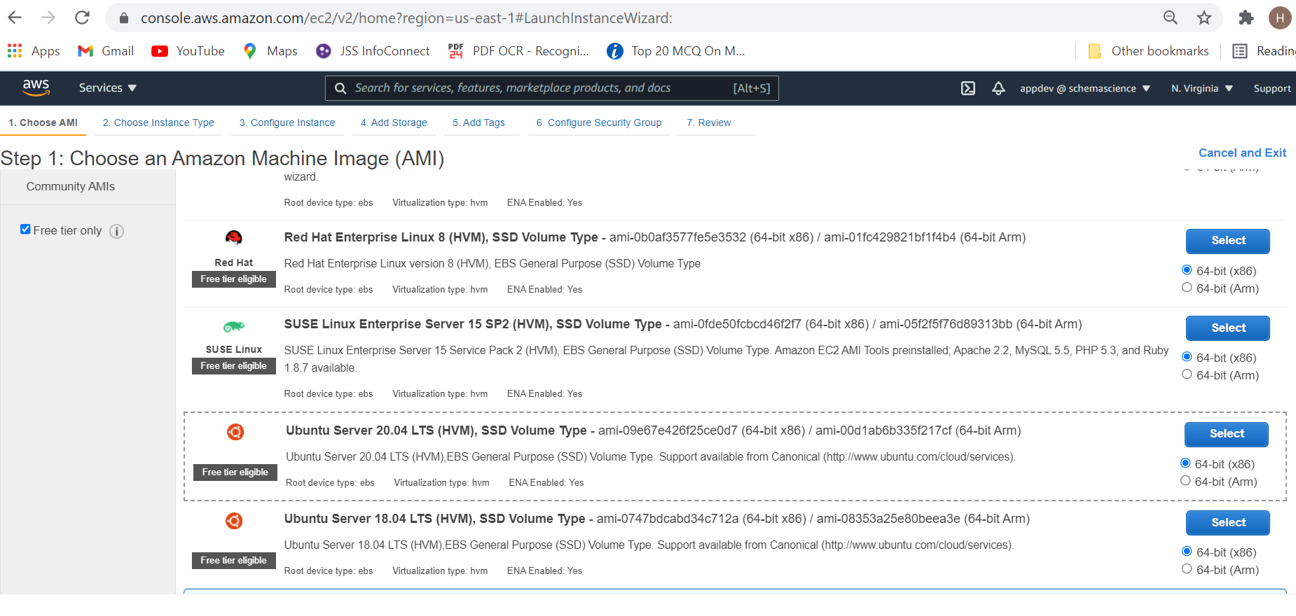

Slide 2
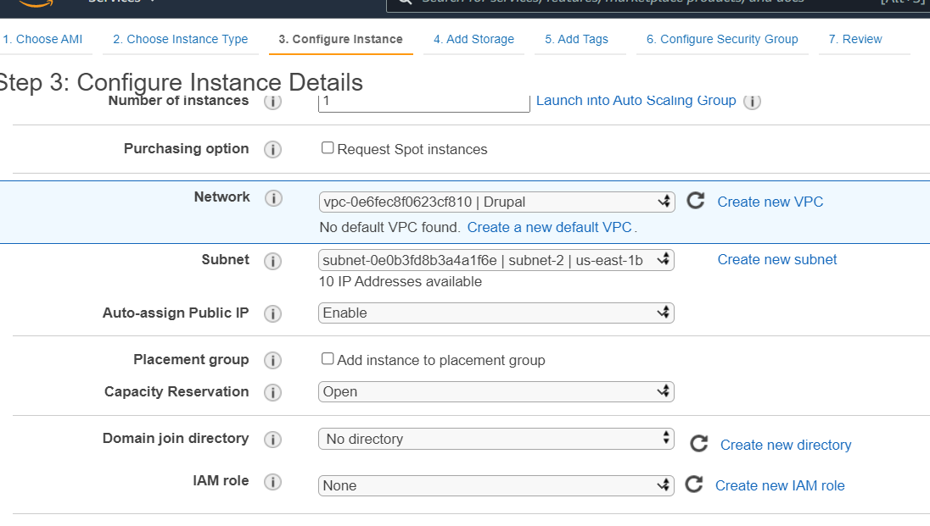

Slide 3
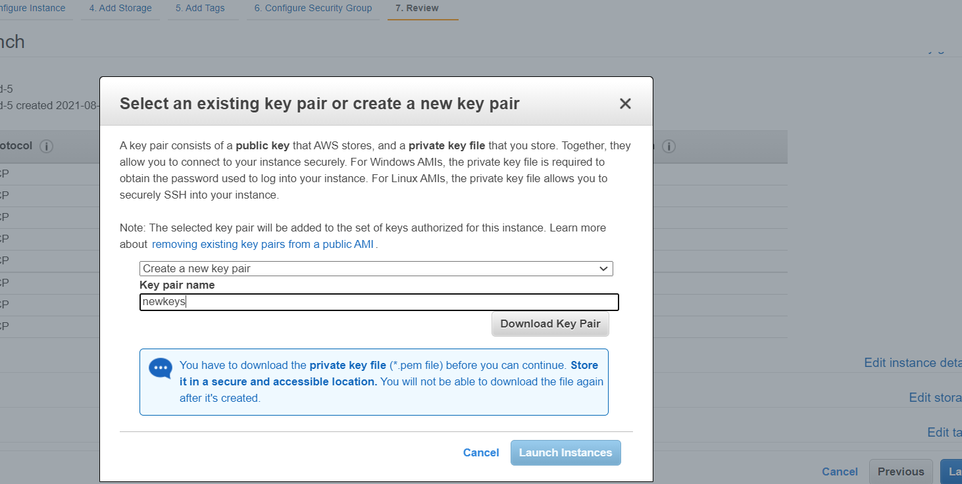

Slide 4
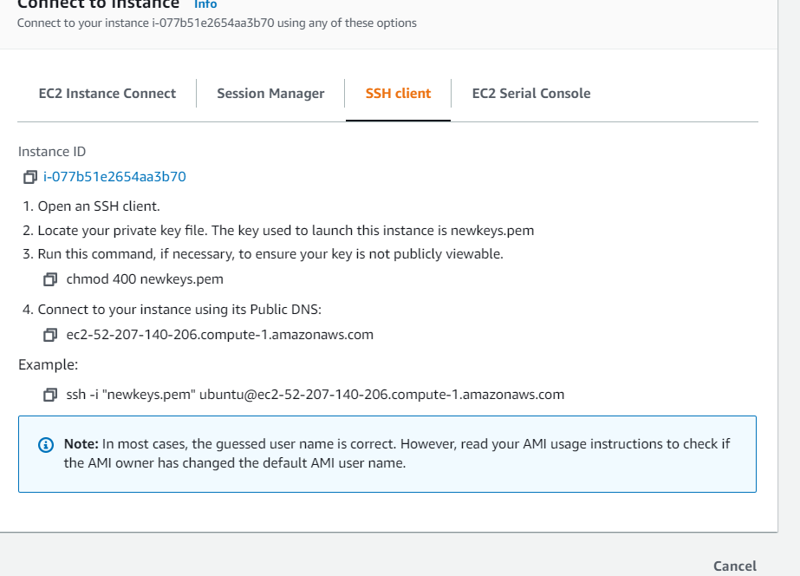
Press connect to instance (newly created)
Save in mind (copy the command)

Slide 5
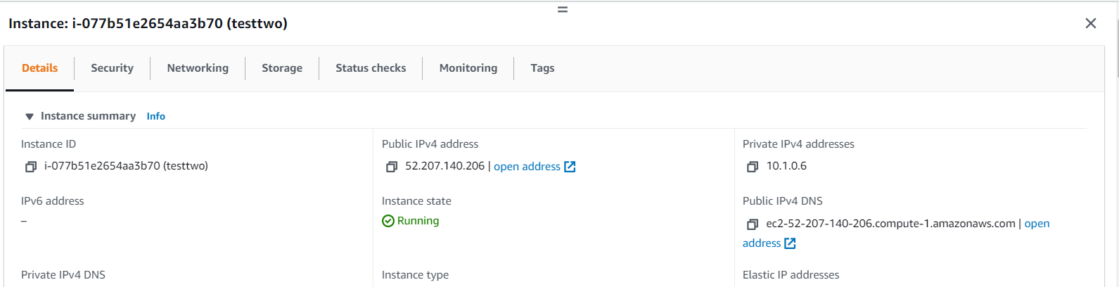
Get public ip address also

Slide 6
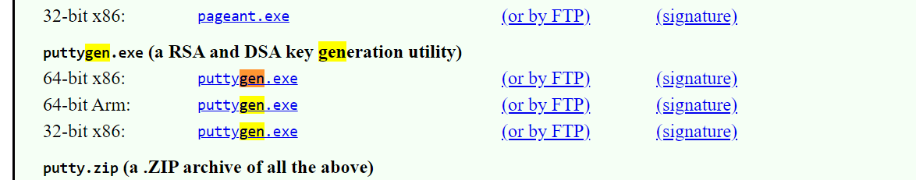
Save generated keys in new folder.
Now open that folder and putty website also

Slide 7
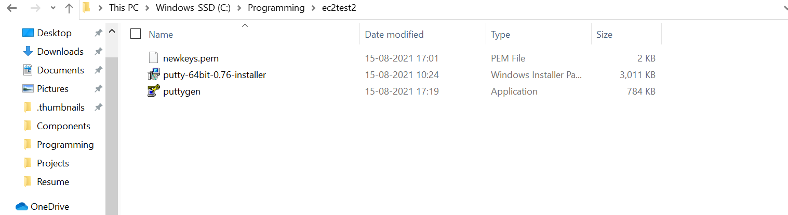
Something do like this

Slide 8
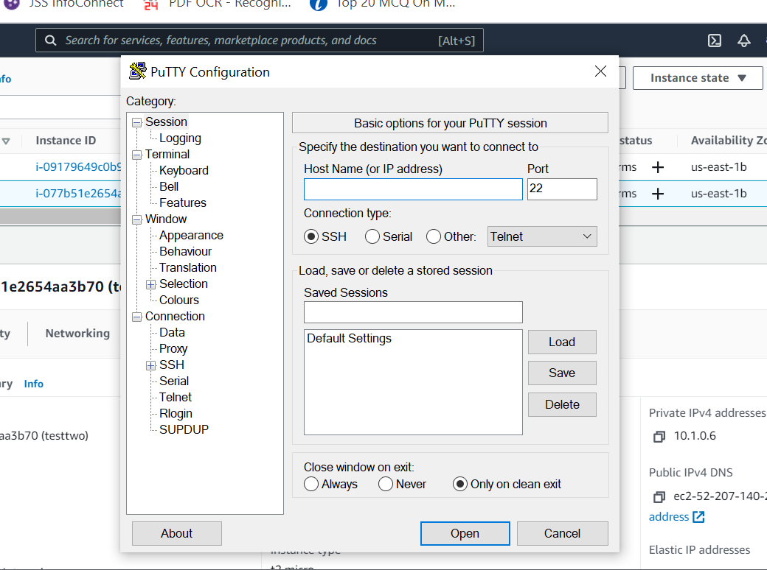
Open putty

Slide 9
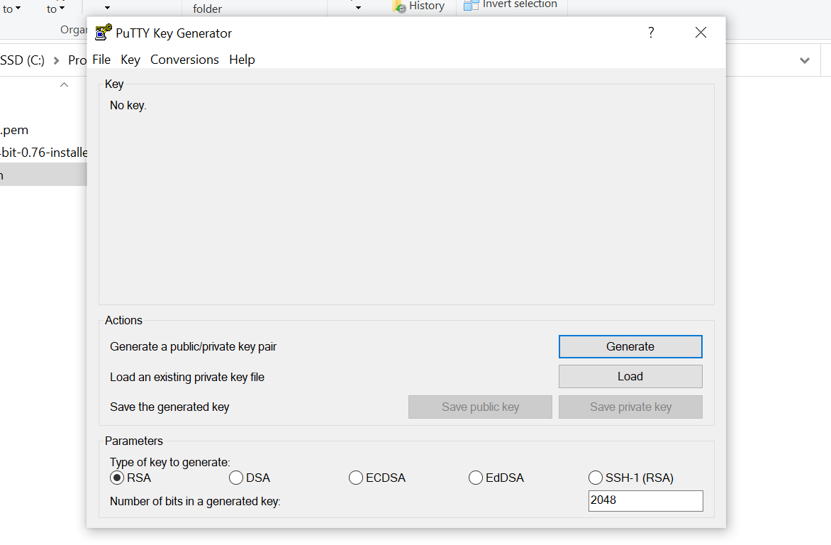
load

Slide 10
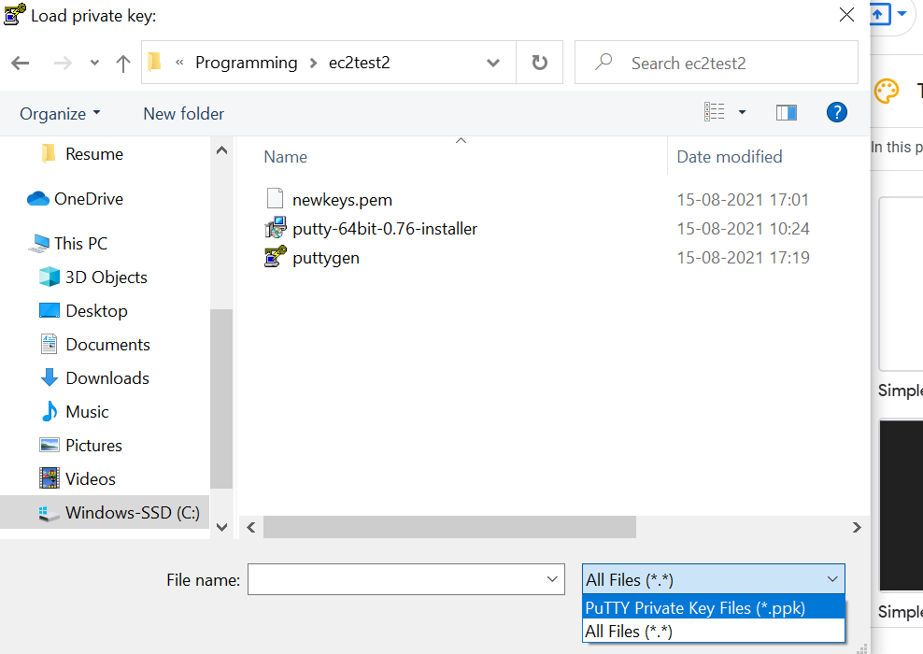

Slide 11
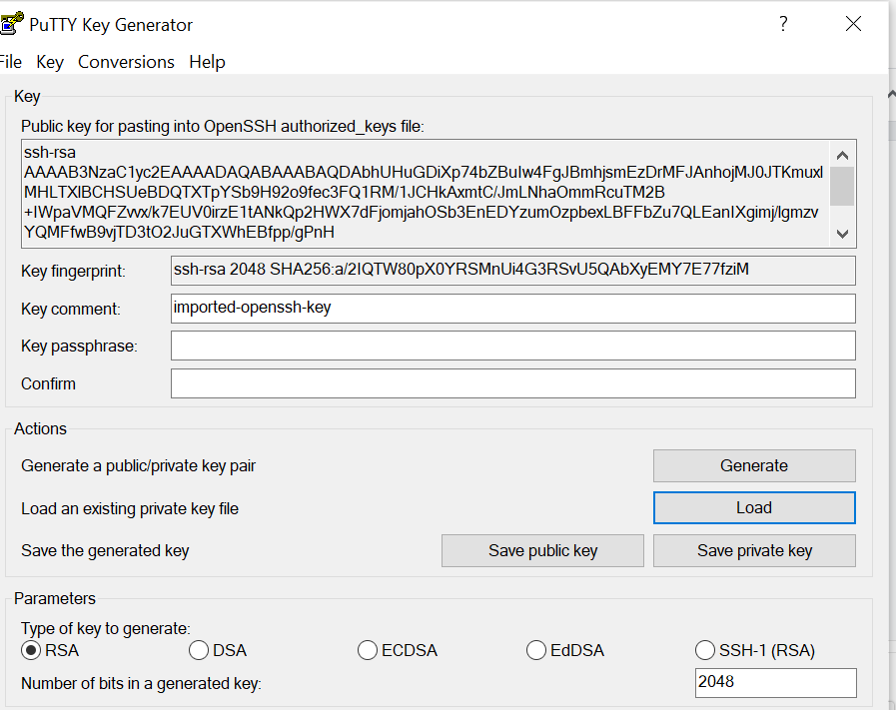

Slide 12
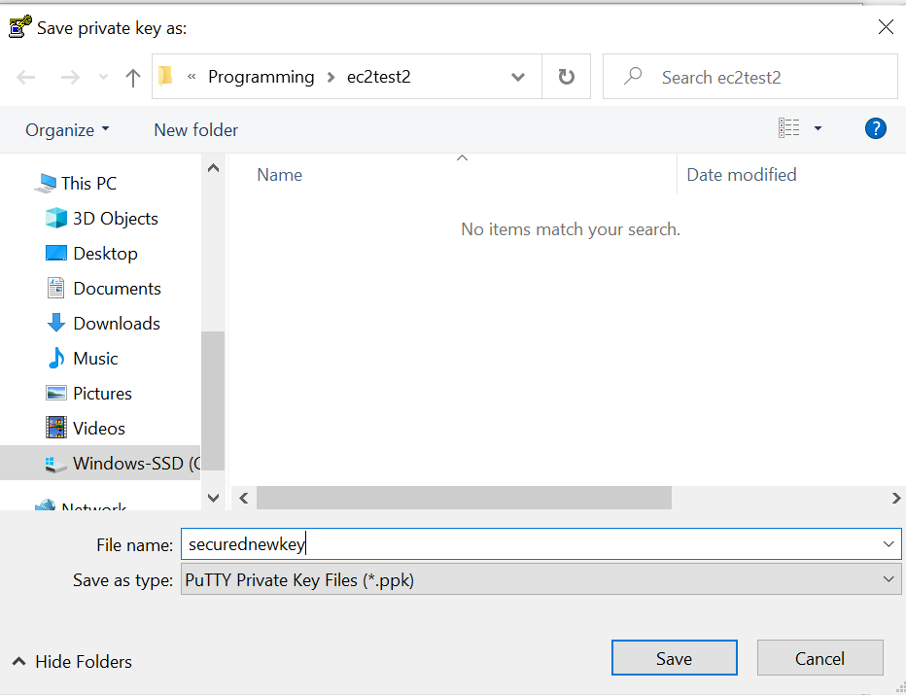
Save private(not public)

Slide 13
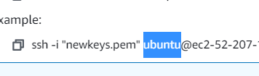
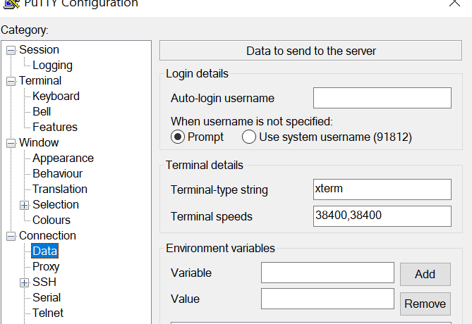
SSH>HOST ----> next page
HOST NAME: Public IPv4 DNS
CONNECTION>DATA>AUTO LOGIN Username:

Slide 14
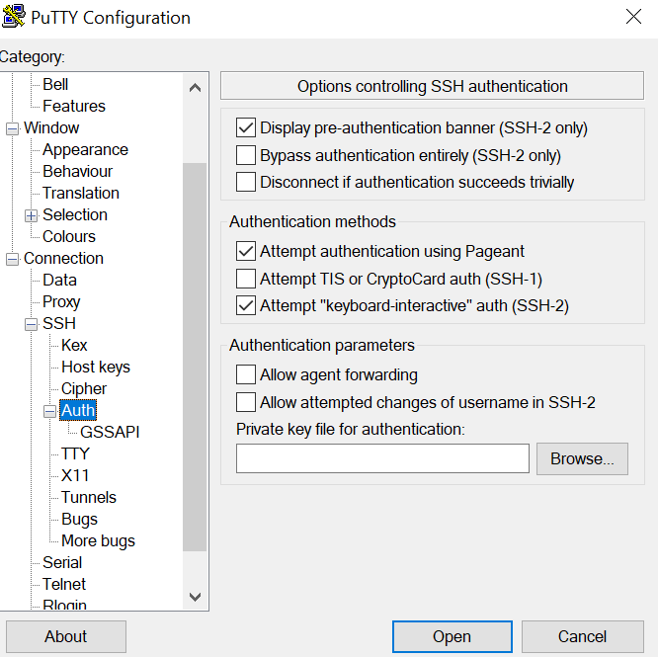
Browse and import compressed keys secured one

Slide 15
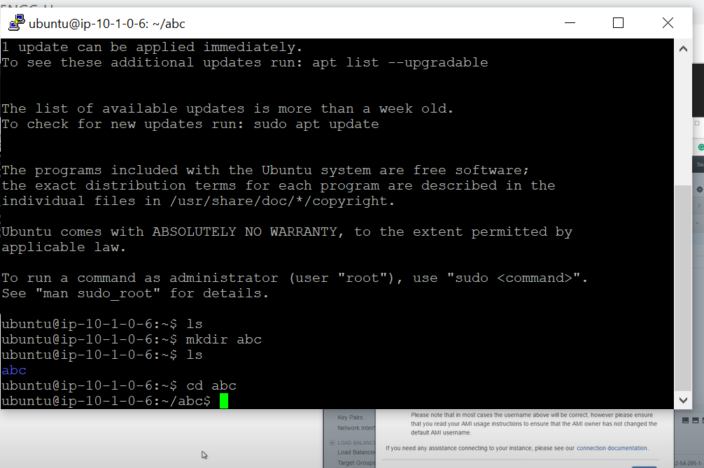

Slide 16
Now commands to write continuously
Sudo apt-get update
Sudo apt-get install npm
Npm -v node -v
Mkdir newapp
Cd newapp
Git clone blabla----.git
Sudo npm install
Sudo npm start

Slide 17
In order to change any file
Sudo nano filename.js
(filedata will open)
Edit it
Ctrl X
Y

